Slide 1




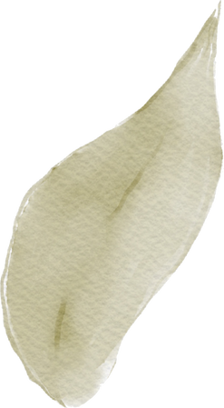

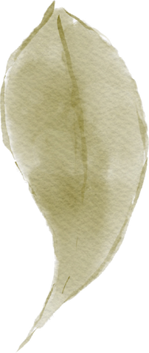


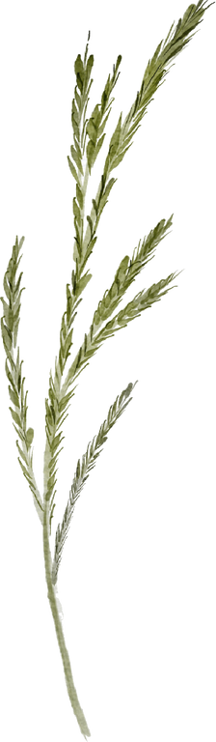

Advanced Numerical Optimization with CasADi
Dr/Mohamed Amir

Slide 2


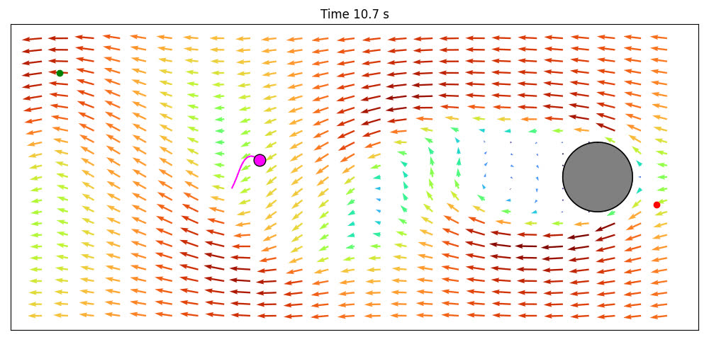



Abstract
Introduce both projects focusing on the optimization of fish navigation using CasADi and the integration of PyTorch models into CasADi through L4CasADi for broader numerical optimization applications.

Slide 3
Introduction
CasADi Overview: Explain CasADi's role in numerical optimization.
L4CasADi Introduction: Introduce L4CasADi as an extension that integrates machine learning models from PyTorch into CasADi.
Usage of L4CasADi : The paper explains how to define and use L4CasADi models within
CasADi's symbolic graph framework, highlighting the ease of use and flexibility in
handling different PyTorch model architectures.

Slide 4
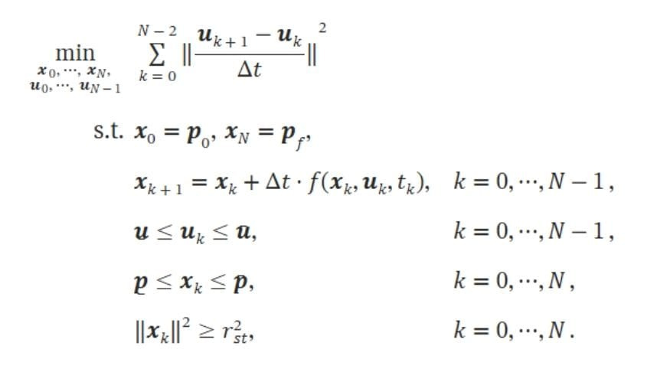
THE Problem

Slide 5
How CasADi Works
Symbolic Expressions: Users can construct symbolic expressions for automatically differentiable functions.
Algorithmic Differentiation (AD): Facilitates efficient sensitivity analysis for systems of equations, ODEs, and DAEs.
Solver Integration: Supports various optimization problems including NLPs, LPs, and QPs.

Slide 6
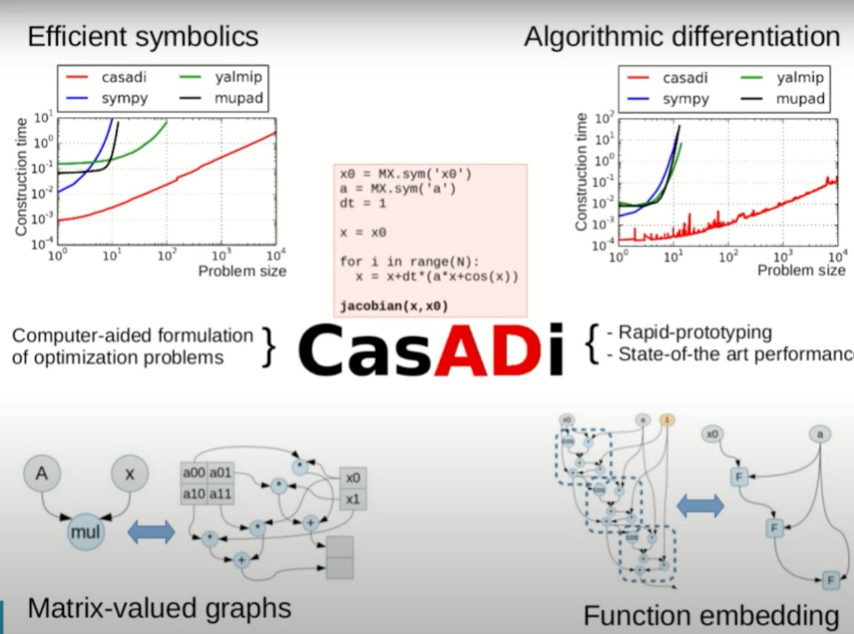
1.

Slide 7
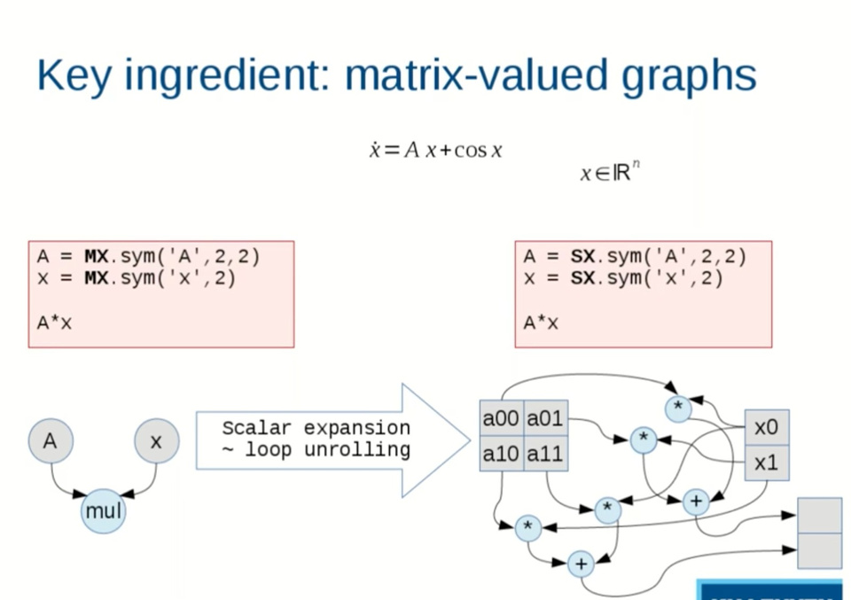
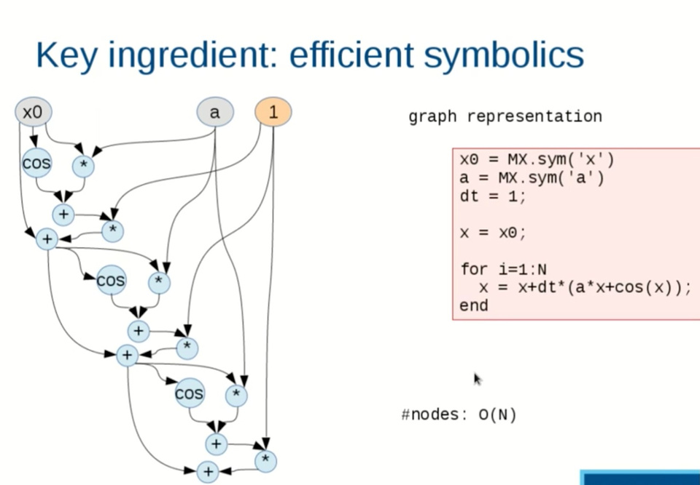
How CasADi Works
2.
3.

Slide 8
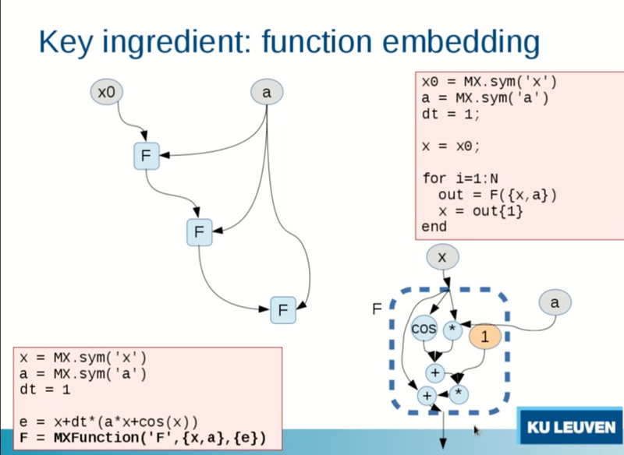
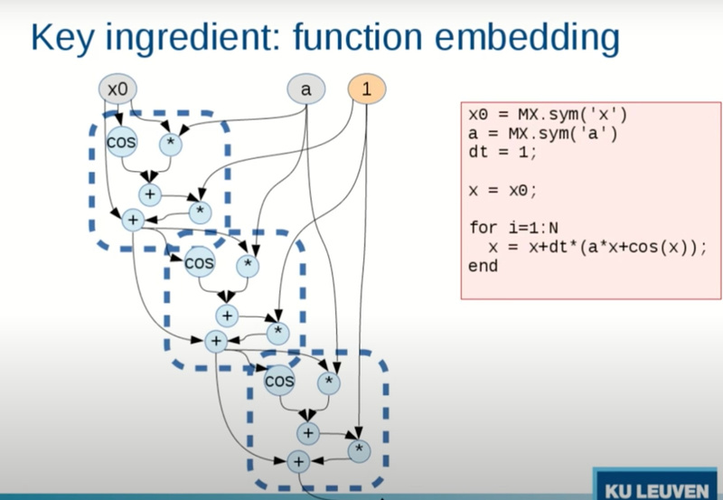
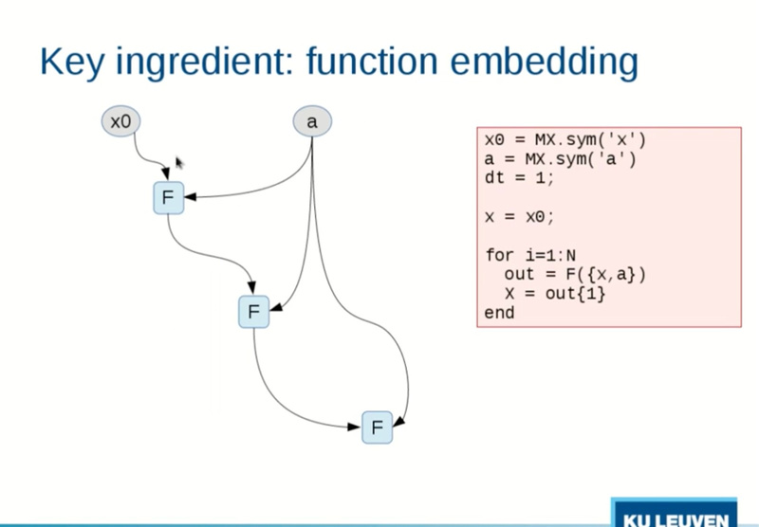
How CasADi Works
4.
5.
6.

Slide 9
CasADi in Action - Applications
Process Control: Optimizing chemical processes for enhanced operational efficiency and safety.
Robotics: Motion planning and control optimization.
Aerospace: Optimizing flight paths and control strategies for aerospace vehicles.
Process Control:
Aerospace: Optimizing flight paths and control strategies for aerospace vehicles.

Slide 10
Recent Improvements in CasADi
01 -sign Shifts:
Focus on optimization and enhanced toolkit design.
: Improvements in AD and symbolic capabilities.
02 - Symbolic Core Enhancements
03 - Interface Enhancements:
Better usability and integration.

Slide 11

Combining CasADi with L4CasADi
Integration Benefits:
Discuss the enhanced capabilities when combining traditional CasADi optimization with L4CasADi's machine learning integration.
Highlight potential applications across various fields like robotics, aerospace, and environmental sciences.
Application Potential:

Slide 12
Detailed Applications
Fish Navigation Optimization:
Neural Radiance Field Optimization
Detail the optimization of fish navigation in turbulent flows using CasADi.
:Explain the use of L4CasADi for optimizing trajectories in 3D environments modeled by NeRF.

Slide 13


Methodology and Implementation
CasADi Optimization Techniques: Discuss the mathematical modeling and solver configuration in CasADi.
L4CasADi Integration: Show how PyTorch models are integrated into CasADi workflows, with code snippets and practical examples.

Slide 14
discussion

Slide 15

In this presentation, we have explored the significant advancements in numerical optimization facilitated by the integration of CasADi and the L4CasADi framework. These tools represent a leap forward in solving complex, real-world problems by combining traditional optimization techniques with cutting-edge machine learning methodologies.ntal sciences.
Conclusion

Slide 16
Thank You
Maram Ashraf Karim Mamdouh
Marina Reda
Sohila Ahmed

